Slide 1

Book Store a library management system Presented by: Abu rishad Id:Cse 06307437 jony id:Cse063074 Abir id: Cse 063 07439

Slide 2
.
INTRODUCTION
A Library Management System is a software built to handle the primary housekeeping functions of a library. Libraries rely on library management systems to manage asset collections as well as relationships with their members
D

Slide 3
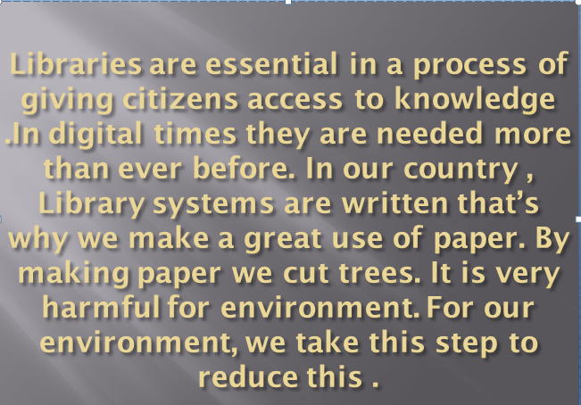
Motivation for this Project

Slide 4
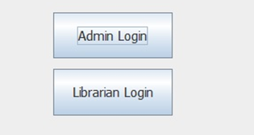
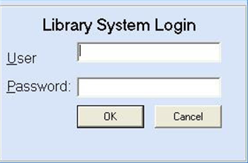
Features

Slide 5
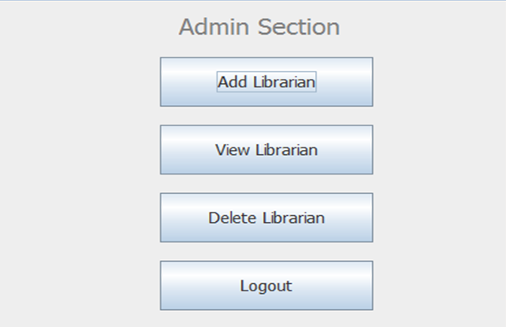

Slide 6
Feasibilities
Technical
Economical
Operational

Slide 7
Technical Feasibility
We can strongly says that it is technically feasible since there will not be much difficulty in getting required resources for the development and maintaining the system as well. All the resources needed for the development of the system as well as the maintenance of the same is available in the organization here are utilization.

Slide 8
Economical Feasibility
Development of this application is highly economical feasible.The organization needed not spend much more for the development of the system already available. The only thing is to be done is making environment for the development with an effective supervision.

Slide 9
Operational Feasibility
User Level
User Interface
Maintenance
Error Handling (User)

Slide 10
Project Scheduling
Planning
Construction
Deployment

Slide 11
Planning
Activity | Description | Precedence | Time (in week/s)
1 | System Design | 4 | 1
2 | Database Design | 5 | 1
3 | Mock-up Database Implementation | 6 | 1

Slide 12
Construction
Activity | Description | Precedence | Time (in week/s)
4 | User Interface Designing | 5 | 2
5 | Admin Panel Designing | 5 | 1
6 | Coding | 5,6 | 4

Slide 13
Deployment
Activity | Description | Precedence | Time (in week/s)
7 | Testing | 8,9,10 | 2
8 | Feedback & Releasing | 11 | 1

Slide 14
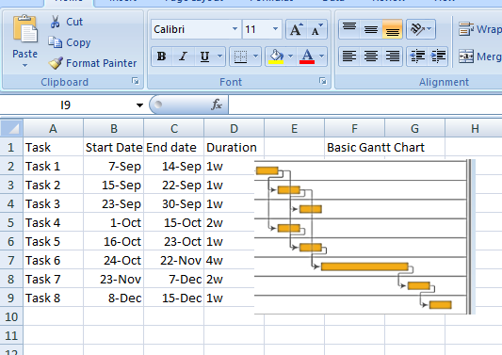
Basic Gantt Chart

Slide 15
Risk Analysis
Backup for Database
Secured Database & Registration Form
Timing Commitment
Hardware Backup

Slide 16
How about a Question !!!

Slide 17


